Slide 1



Fighting for a Sustainable World
The EU contributes 18% of total global warming gas emissions; However, it is increasingly determined to take the lead in the fight against climate change. That is why it has set itself the goal of reaching zero carbon emissions by 2050.
To this end, it has put in place a wealth of resources to help achieve this goal over the next few years, and it will need your help to do so.
Author: Juan Sirai

Slide 2
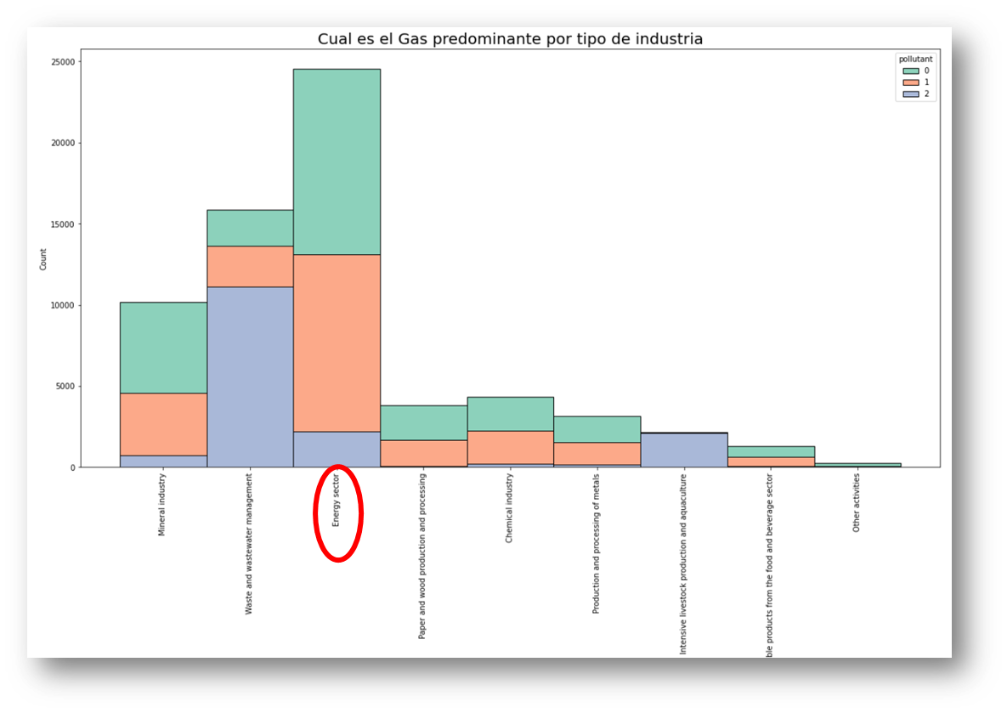
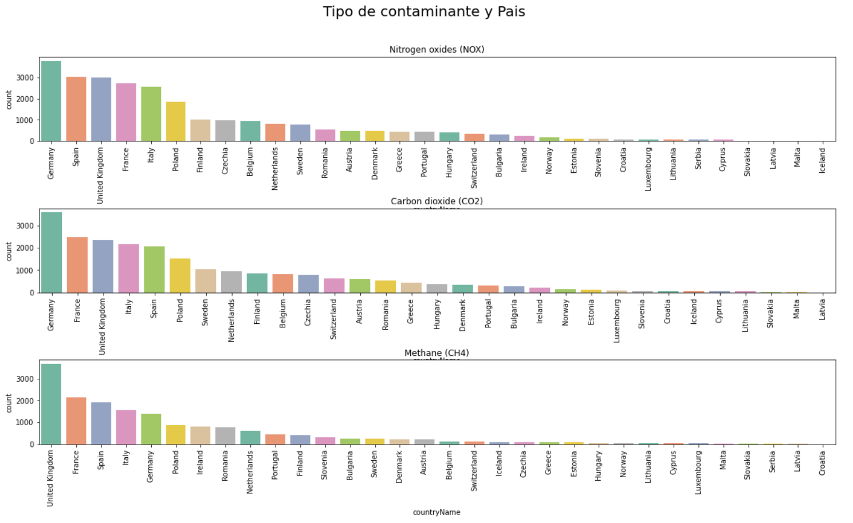
Schneider Electric Hackaton
As habitants of this world, it is our duty to worry about its preservation for the rest of living beings, and future generations.
Currently, the production models that have enabled a significant improvement in the quality of life are generating severe climatic consequences, which, if measures are not taken in time, could end our planet as we know it.
The energy industry, although it is the engine of the evolution of societies, is one of those that generates the most pollution in the air.

Slide 3
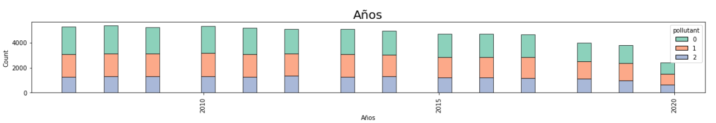
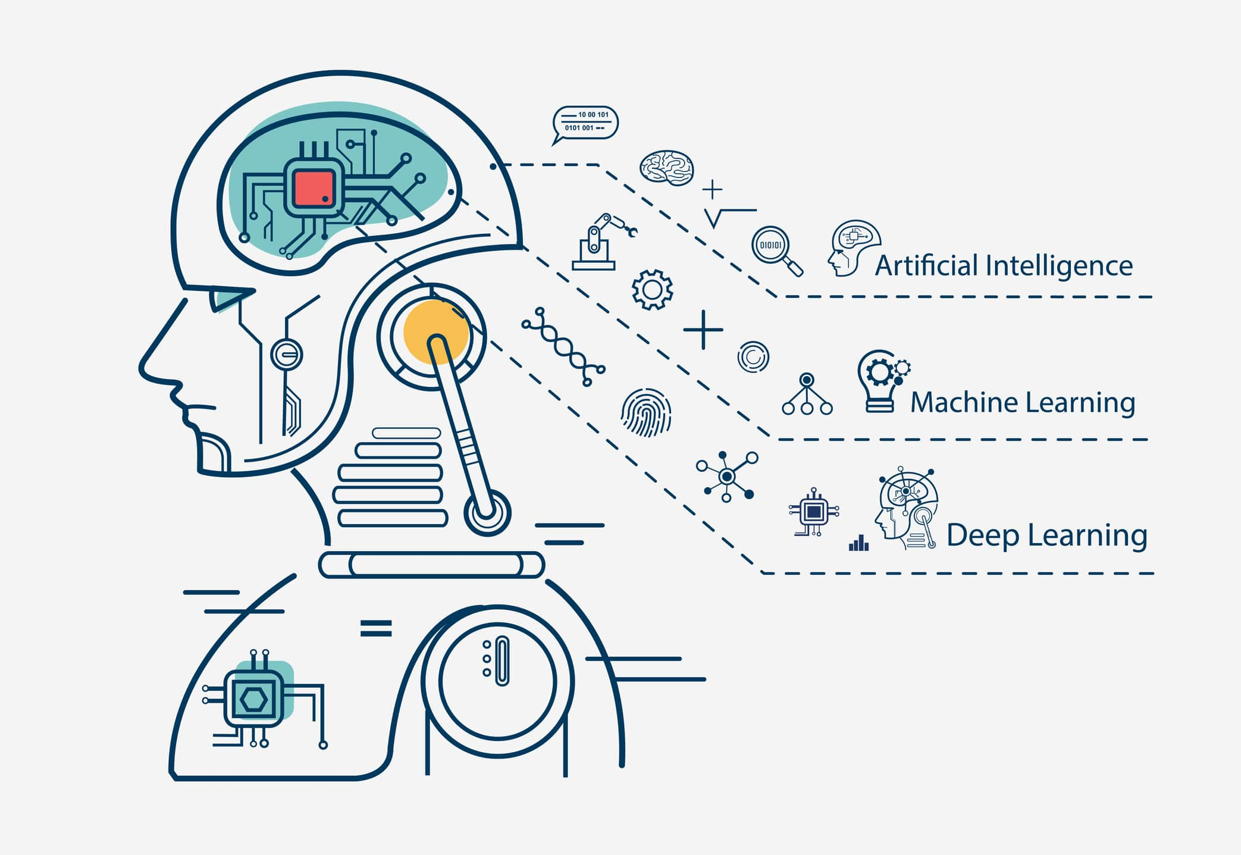

Schneider Electric Hackaton
Fortunately, over the years the efforts to reduce gas emissions are being noticed.
In this project, we are going to try to predict the type of pollutant generated, with the help of Machine Learning, do you want to take a look at it?

